Slide 1

Using Data Driven Solution to Detect & Prevent Fraud for Caratlane
Team – PYCO2022
Anupama Rathore
Ajith Chadagap
Kailash Negi

Slide 2

CARATLANE CUSTOMER JOURNEY
Awareness
01
Engagement
View Online ad, social media campaigns
Browsing across product pages, clicks, etc.
04
02
Retention
03
Conversion
Reviews, making another purchase, bringing more customers
Product purchase and payment

Slide 3
We track activity of customers using device id and IP Address on the app/website
Add to Cart
We look at Quantity and Volume of Transaction
Checkout
Check the Location from where customer is making transaction and if its from unknown location for registered customer and unexpected location for an unregistered customer
Check if the order quantity/volume is more than a threshold (which Caratlane can set)
The AI system or model will check for possibility of suspicious activity basis these actions
Check if the amount of time spent from same device or IP Address on the Caratlane app/website is surprisingly long or short before making a purchase
Based on past transactions from same device or IP Address check if customer is making multiple transactions in small denominations
Location Specific
Looks Suspicious?
Raise appropriate triggers and decline the transaction
Volume/Quantity specific
Yes
Number of transactions specific
No
Surprisingly long or short browsing on Caratlane app/website
Let the transaction go through

Slide 4
Machine Learning Work Flow
CRISP- DM Approach
Define
Data
Explore
Model
Evaluate
Deploy
Business
Understanding
Data
Understanding
Data
Preparation
Machine
Learning Techniques
Access
Basis the business criteria
Automation & Optimizations
Customer Journey on Caratlane Portal
Sample Online Data
collected from Public sources
Descriptive Analytics, Clean Data, Format Variables, Correlation
Generate Test
Design. Build & assess the model
Synthesize the model output in terms of good & bad outcomes
Setting Monitoring Triggers & Maintenance outputs

Slide 5
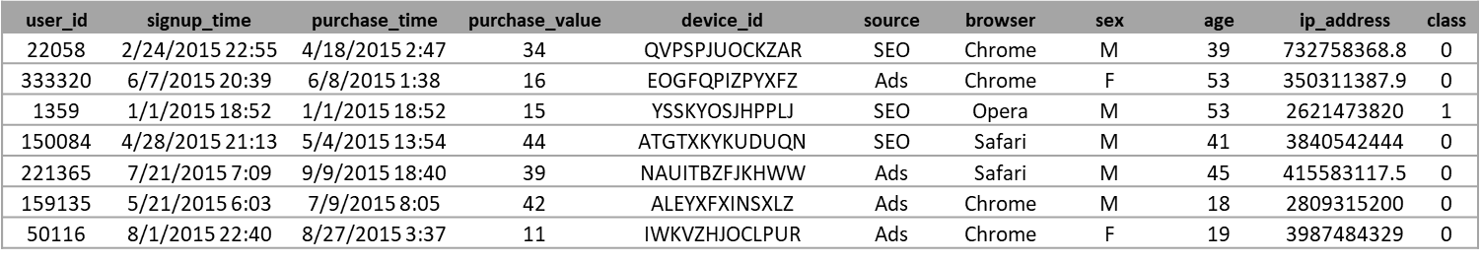
Sample Data Summary
Online Transaction Data with 15,110 Transactions and 11 features
Assuming that the Caratlane website/app should be generating similar data points, the sample dataset comprises of Unique Customer ID, information on customers’ activity such as sign-up time, purchase and purchase value, demographics such as sex, age and IP address and device usage were used to explore and build a model.
-- Awareness in terms of Reach and the sources
-- Conversion Time calculated using the difference in days between sign up time and purchase time (assuming it was the first purchase)
user_id - The unique id of the Customer
signup_time -The time at which the Customer signs up into the portal
purchase_time -The time at which the Customer performs any purchase from the portal
purchase_value - The amount at which the customer buys
device_id - device id is specific to the device what the customer is using
source - The channel used by customer to get into the portal
browser - Search engine used by customer during their search in the portal
sex - Customer Gender
age -Customer age
ip_address - Customer IP Address
class - Target variable [1- Fraud transaction , 0 - Successfull Transaction]

Slide 6
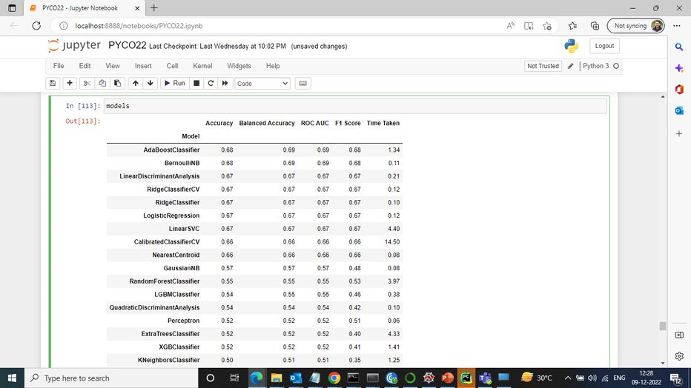
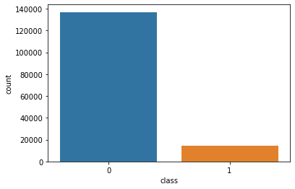
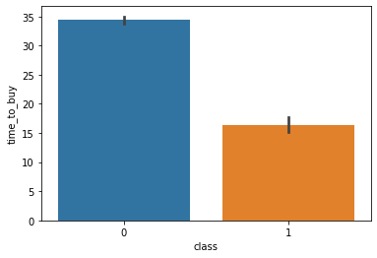
Model Output
Correlation, Under-sampling, one Hot Encoding, Normalization, Lazy Predict
From the sample dataset-
Overall, 9 % Fraud Cases, with max value of 20K
Non-Frauds Transactions Max Value approx. 1.4 Lakhs
Min & Max days to make the first purchase from signing up ranging from 1 to 337 days
In case of Fraud transactions, Average time taken to make the first purchase were close to 17 days
BernoulliNB and AdaBoost are the best models with an accuracy & F1- Score of 68% using Lazy predict

Slide 7
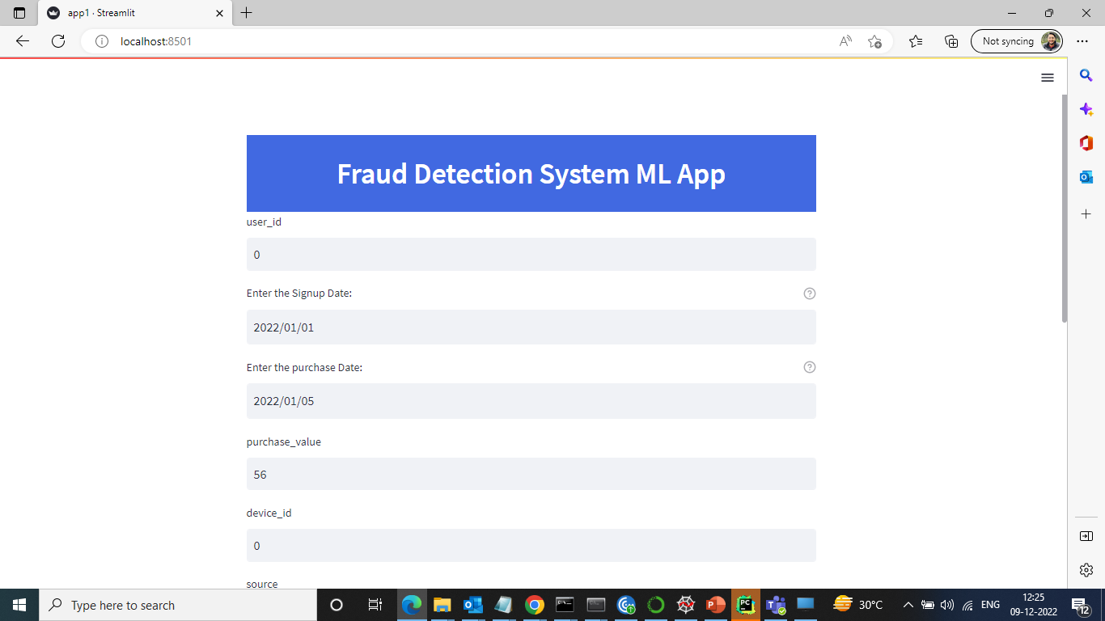
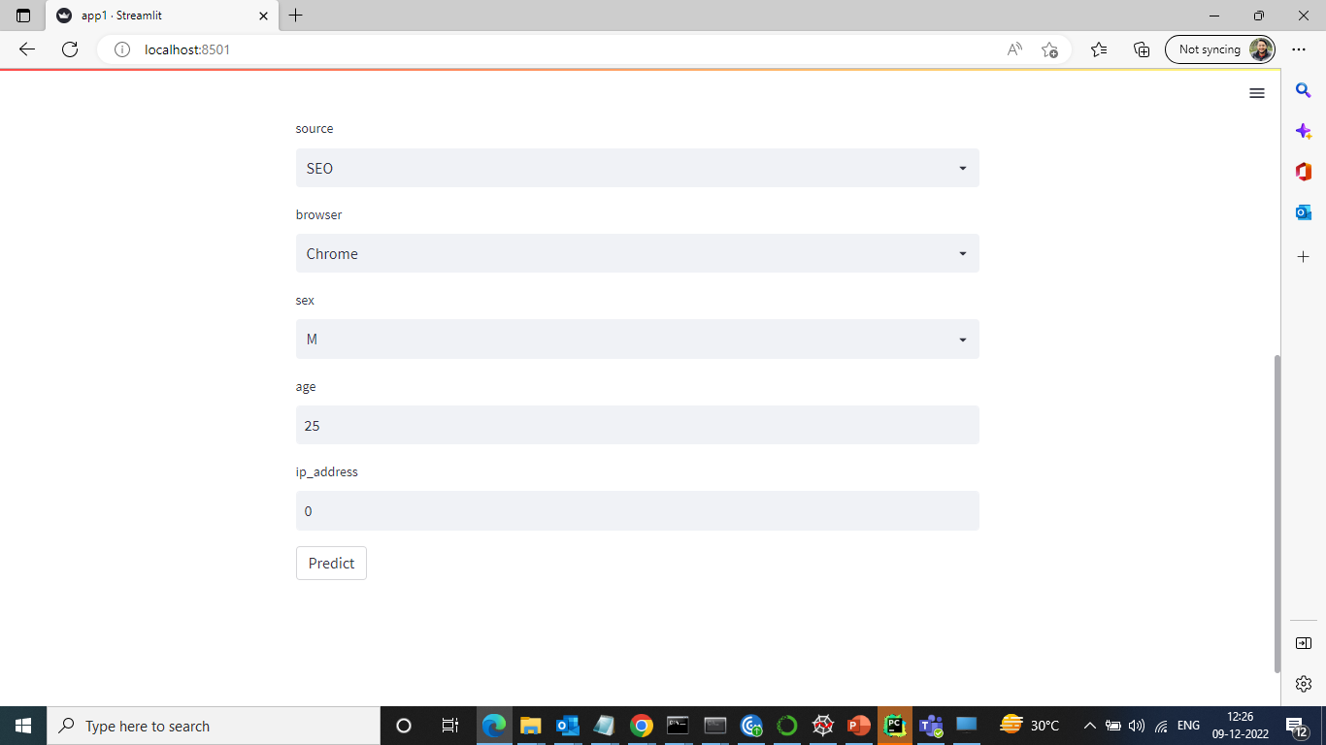
StreamLit UI Prototype
https://ajith1892-pyco22-app-ckphil.streamlit.app/
As a first step, the Detection system will check for Transaction being a Fraud or Non-Fraud, basis that, we can further create triggers on:
Location in terms of IP address, billing address
Min-Max Quantity per Transaction or invoice
Min-Max Values Purchased per Transaction
Unusual Time Spent on Page Views, Product Views or Multiple Clicks on specific SKUs
Loyalty Frauds such as unusual high rates of points being purchased, redeemed, or transferred between accounts

Slide 8
Happy to take Questions & Feedback! Thank you

